Slide 1
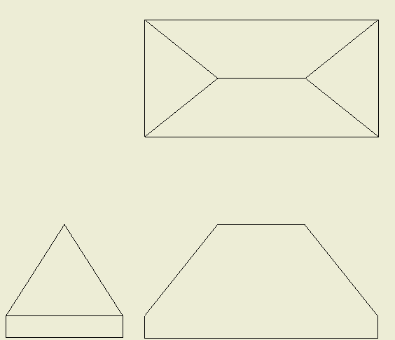
True Shapes
Pointers for the Exam
You will not be asked to draw a True Shape in the exam but you must know how it is constructed and how to identify the true shape from a selection of examples.
Worked Example
Choose the view that shows the surface as a single line.
Project at 90⁰ from the line.
Draw a datum line at 90⁰
To the projection lines.
Take the widths from the datum line on the plan and mark onto the projection lines.
1
3
Datum line
2
Datum line
3
True shape
Tips
(1)2
Widths always come from the plan
Height always come from the view that shows the surface as a single line.

