Slide 1
Economics
Most products are much cheaper to buy today than in the past.
Due to the economies of mass production
The more a process produces, the cheaper each item becomes.
The use of modern materials, e.g. plastics, means that complex items can be produced by a single process like injection moulding.

Slide 2
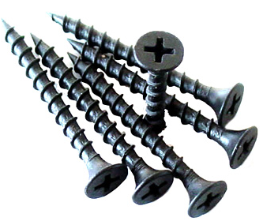
Economics
Savings can be made by careful selection of the most suitable materials and processes.
Designers also make use of standard components to reduce costs, for example with bulbs, switches, simple fixings to alternators and even whole engines.
Manufacturers will often use facilities in other countries where labour costs are lower than at home. Many products are manufactured in countries such as China or Korea where labour costs are very low and efficiency is high compared to Europe.

Slide 3
Economics
The price of a product depends on creating a balance between:
Manufacturing costs
Advertising and distribution costs
Design and development costs
Profits, overheads and reinvestment
Prices set by other manufacturers

Slide 4
Value for Money
To determine whether a product is good value for money you must consider several things:
Is it worth the price it is sold at?
Consider its quality, how well it performs its intended purpose as well as other design factors such as its aesthetic and ergonomic qualities.
Compare the price with like or similar products.

Slide 5
Ease of Maintenance
The maintenance requirements of a product depend a great deal on its life expectancy.
A cheaper product is probably intended to be thrown away after use and will need no maintenance.
A more expensive product is likely to last much longer and will require periodic maintenance to keep it in good order.

Slide 6
Ease of Maintenance
Making allowances for maintenance in the design of a product (i.e bolting on the panels of a washing machine to allow access to repair or replace parts) inevitably results in a more expensive product.
In the higher-cost market niche, this may be justified, but at the lower end of the market the increased price may result in a product pricing itself out of its market niche.

Slide 7
Running Costs
The consumer may or may not see this as an issue, but in general the less wealthy user of a product will be more likely to be concerned about its running costs.
The more affluent will be more concerned about things like the product’s aesthetics and efficiency.

Slide 8
Running Costs
For the designer, the product’s running costs have to be considered in terms of its market niche.
Running costs tend to be made up of:
Fuel/energy consumption
Maintenance costs
Depreciation.

Slide 9
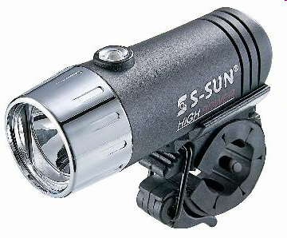
Task
When buying a cycle lamp a teenager can choose between a cheaper model with disposable batteries or a more expensive version with rechargeable batteries.
In terms of running costs, discuss the issues this youngster should consider before making the choice.

Slide 10
Task – Suggested Answer
Cost is obviously the main issue here as teenagers do not usually have much money.
When deciding which lamp to buy the teenager must consider how often he/she will be using the bike after dark. For example, if the teenager has a paper round and will be using it every morning or if they have an evening job and cycle home each night it may be worth while spending that extra bit of money on the purchase of the rechargeable lamp.
However, if they only used the bike at night or early morning on the odd occasion, it would probably make sense to purchase the cheaper alternative and replace the batteries every once in a while.

Slide 11
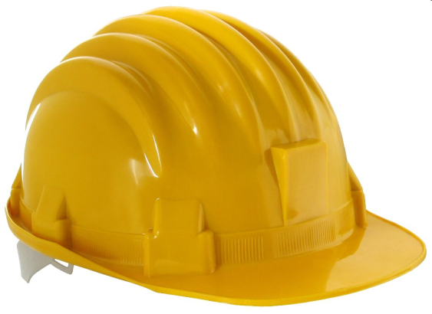
Safety
All new products have to comply with regulations laid down by law or by guidelines issued by organisations such as BSi (British Standards Institution) and ISO (International Standards Organisation).

Slide 12
BSi / ISO Standards
UK and EU Governments will work with these agencies to set new standards.
The EU for example requires that seat belts are fitted to all new cars and that these should be to BSI/ISO standards.
When a product is manufactured to these standards it is indicated with the regulation code number and BSI/ISO logo

Slide 13
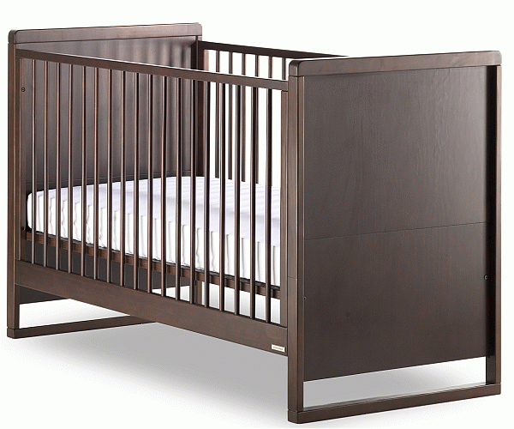
BSi / ISO Standards
BS 1877-10:1997
BS 7177:1996
The specification
for safety
requirements and
test methods
regarding domestic
bedding with
specific specification
for mattresses
and bumpers for
children's cots,
perambulators and
similar domestic
articles.
The specification
for resistance to
ignition of
mattresses,
divans and bed
bases.

Slide 14
Safety
Designer has a responsibility to ensure that the product is safe and complies with the appropriate safety regulations for the countries it is sold in.
Designers have been sued for negligence.
As a consequence designers must make every effort to create products that are safe to use by carrying out stringent functional tests.

Slide 15
Common Sense
Companies must also ‘cover their backs’ by including common sense instructions for the safe use of the product so that if a consumer does have an accident the manufacturer is not liable.

Slide 16
Common Sense
For example, the instructions for a set of electrical garden hedge cutters might include advice that the user should always wear safety goggles (not provided), the electrical cable should not be cut, the product should only be used outdoors in the dry and that the user should not overreach when using the cutters with a set of ladders!

Slide 17
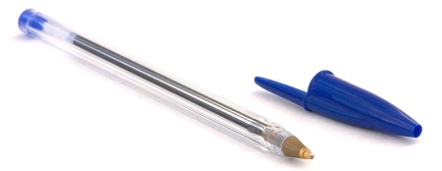
Government Legislation
Unsafe products have to be redesigned...
Plastic pen tops caused a number of deaths in young children when accidentally swallowed. The pen top was modified.

Slide 18
Safety
Vital to success of product.
BSi/ISO assess risk, likelihood of damage.
Safety proofing is expensive
Impossible to make product risk free.

Slide 19
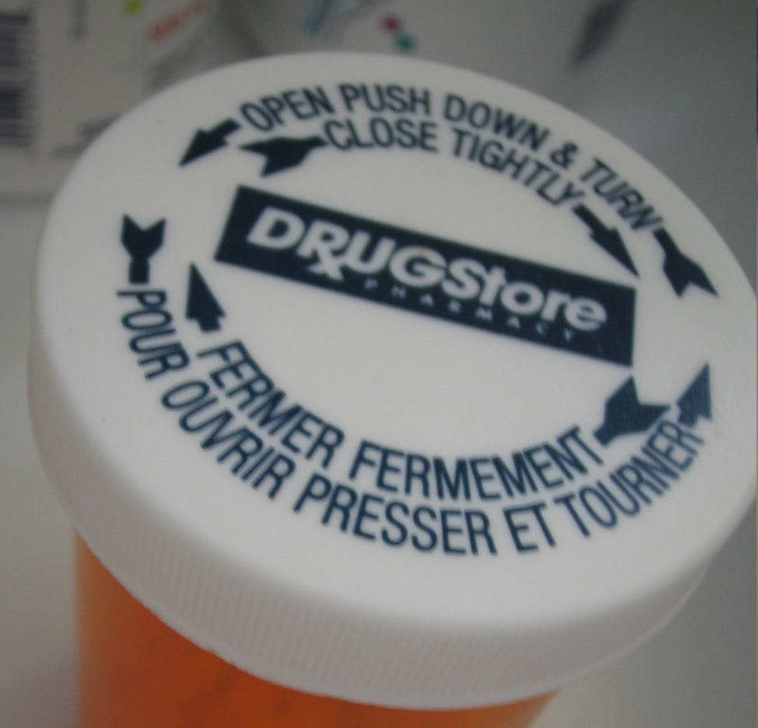
Safety
Bottle tops that require to be pushed and twisted before they can be opened make it more difficult for young children to get access to the contents.

Slide 20
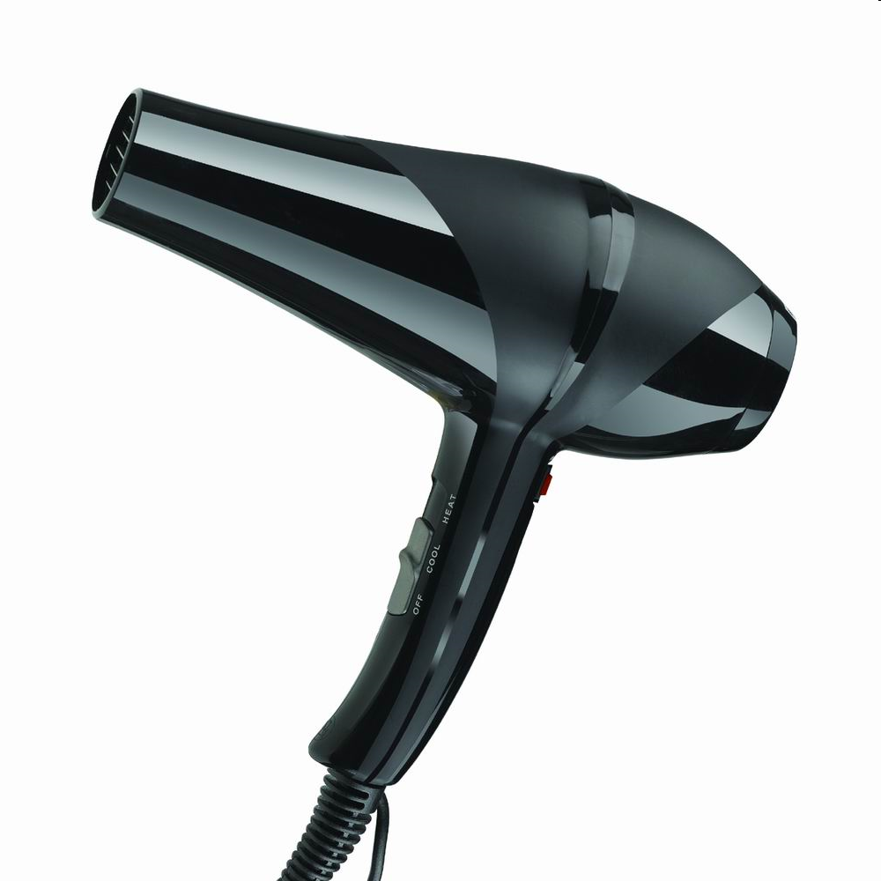
Safety
Many electrical products now require a special tool to allow access to parts that might be repaired or replaced.

Slide 21
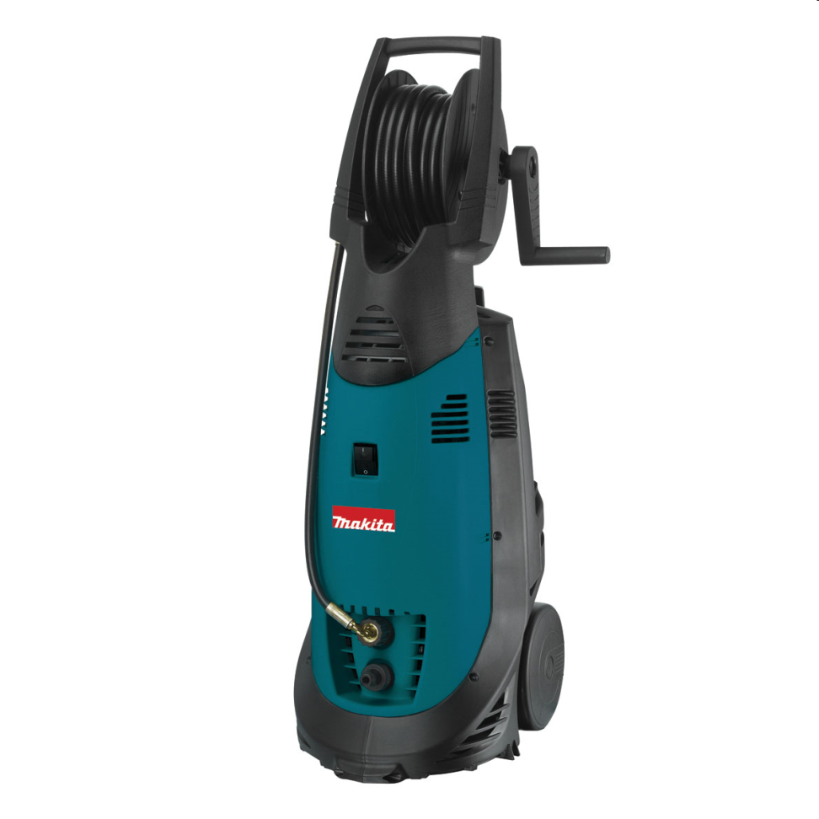
Safety
Power tools which are to be used outdoors must be double insulated.

Slide 22
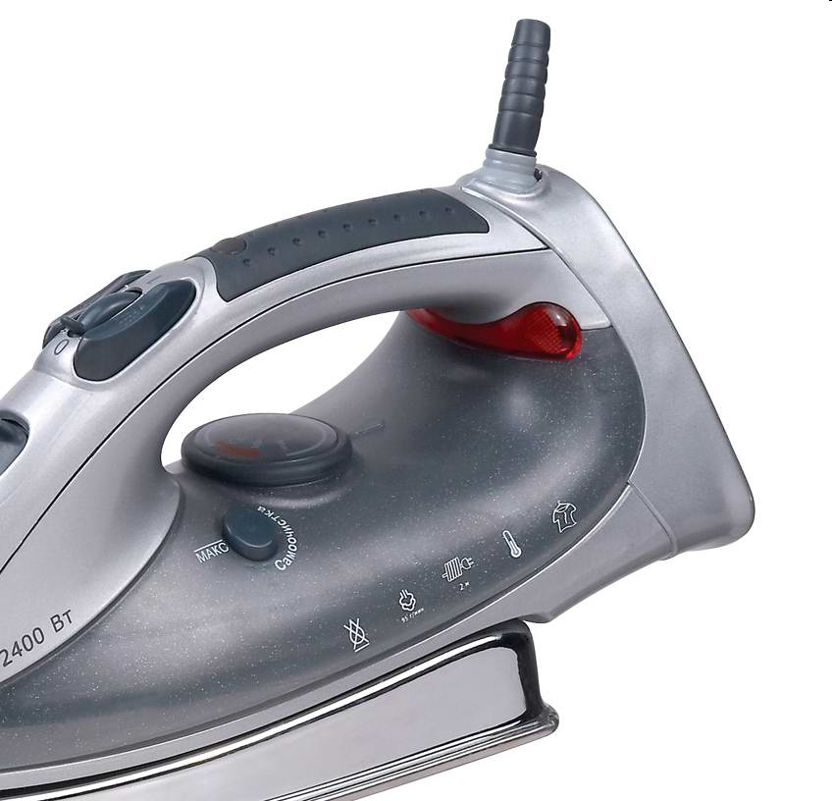
Safety
New materials and a redesign of the method used to attach the flex to an iron have all but eliminated the risk caused by frayed and worn flexes.

Slide 23
Task
Google “ceramic knife” and list several facts with regard to Safety & legislation.

Slide 24
What is Intellectual Property?
Creative processes generate new ideas, whether in the field of product design, music, art or elsewhere. These ideas, which may have commercial value, are the intellectual property (IP) of the creator, whether they are an individual or a company organisation.
Have enormous commercial value, and can be traded as a commodity.

Slide 25
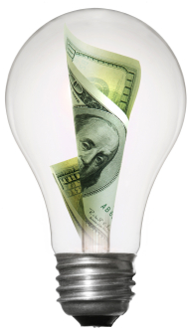
What is Intellectual Property?
Commercially valuable ideas can be at risk if not carefully protected, and others may gain commercial advantage as a result.
Over the last three hundred years five different types of IP protection have been developed on top of the first type ever used: Confidentiality.

Slide 26
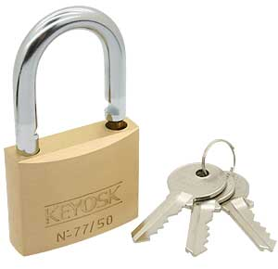
Intellectual Property
These six types of protection are:
Confidentiality
Copyright
Trademark
Design right
Registered design
Patent.

Slide 27
Confidentiality
This the big name for secrets. Secrets have been around for a long time, and they are cheap to keep as long as the people keeping them can be trusted. In general, the fewer people who know a secret, the safer it is.
Some companies use confidentiality rather than patents because applying for patents results in the application becoming public. Not much use if you are designing a top-secret product!
But secrets are not much use for some people. For example, protecting a new tune with a confidentiality agreement would mean that the composer would never earn any money, as no one would be able to hear it.

Slide 28
Confidentiality – Example
Only three people in the world know the exact recipe for Barr’s Irn Bru. Until recently they were all members of the Barr family, but now one of the company employees has the ‘know how’.
The reason that the recipe is kept secret is that competitors have to guess how to copy it, whereas if it was patented they could visit the patent library, find out exactly how it is made and alter their own brew slightly, and not to infringe the Barr patent.
Some agreements prohibit those ‘in the know’ from travelling together in the case the secret is lost due to an accident.

Slide 29
Confidentiality – Process
A confidentiality agreement is usually drawn up by a solicitor and is signed by those ‘in the know’. This is then legally binding and any breach could result in legal action.

Slide 30
Task 1
Try to find some other examples of well known ‘secret recipes’.
Explain why Barr’s Irn Bru is kept secret and not patented.

Slide 31
Copyright ©
Copyright is used mainly to protect written, printed or broadcast materials, and is relatively simple to use.
It actually exists on any written piece, the copyright usually belonging to the author automatically, although it can belong to the company employing the author if that has been agreed.
The copyright can be bought and sold in the same way as any other commodity.

Slide 32
Trademark
Trademarks are all around us nowadays.
Most logos that you see on anything from adverts to clothing are Trademarks. They identify the product with a company, and the company hopes that its image will help to sell the product.
Trademarks have been registered since 1876, at the Patent Office.
Trademarks are usually words, although it is becoming more common for other items to be protected in this way too, for example tunes (T-mobile) and aromas (perfumes, etc.).

Slide 33
Trademark
Companies protect their names to prevent other competitors from copying or ‘passing off’ their products.
It is common practice not to trademark the company’s own name, but only the ‘brands’ that they produce.
Some companies may wish to protect their company logo and in some cases this can be done, for example Nike.

Slide 34
Task 2
Make up a trademark for an imaginary product you have invented.
If internet access to the Patent Office website (www.patent.gov.uk) is possible, conduct a search in the Trademark Register for your invented name to see if anyone else is already using it and if so, what for?
What is the difference between the meaning of the two symbols, ® and ™?
Sketch from memory three trademarks and then compare them to the originals. Observe how recognisable the best designs are, and try to explain what it is about the designs that makes them so effective.

Slide 35
Design Right
Design Right is a new form of IP that was introduced in the UK in 1988 and which is very similar to Copyright, although there are some important differences.
Design Right’s main similarity to Copyright is that it exists automatically, i.e. there is no application process involved.

Slide 36
Design Right
Offers less protection, and is really only suitable for protecting items that fall outwith the other forms of IP protection.
Due to its simple nature it is also a cheap form of protection.

Slide 37
Design Right – Examples
Design Right is particularly useful for protecting the way things look; shape, form and appearances of products that are different from before but sufficiently so to allow for patenting.
For example, the appearance of a new toaster may be protected by Design Right because underneath the stylish case are the same mechanisms as the previous model’s.

Slide 38
Design Right – Process
As there is no formal registration system for Design Right, all that needs to be done is to mark the work ‘Design Right’ and date it.
It is a good idea to keep the idea secret until this has been done and an original has been kept somewhere secure with proof of the date when it was done.

Slide 39
Design Right – Process
Design Right only protects the idea in that specific form, and it is easy for competitors to copy with minor changes so as to avoid infringement of the Design Right.
DR has a short lifespan of only 10 years from the first sales, and during the last 5 of these anyone is entitled to copy the design provided they pay a licence fee to the owner of the IP.

Slide 40
Registered Design
Registered Design is a form of IP protection that was first used in 1787, in response to the demands of the textile manufacturers who were concerned about competitors using their patterns.
It is still much used by industry today as this form of protection covers the appearance of a product, but not how it works.

Slide 41
Registered Design
If the way it works is new then a Patent may be applied for, in addition to using Registered Design to protect its appearance.
It is important to understand that one product may involve several or even all of the forms of IP protection.

Slide 42
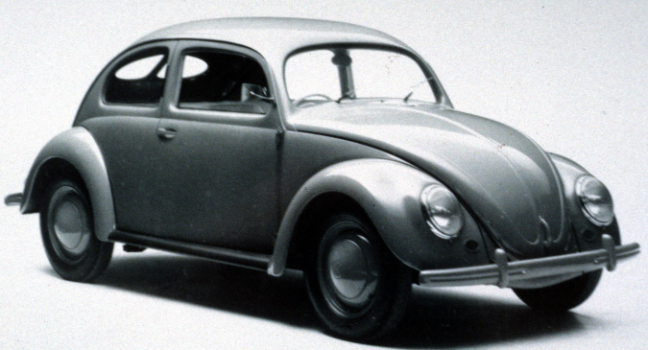
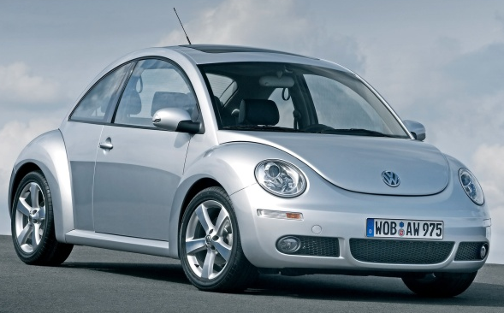
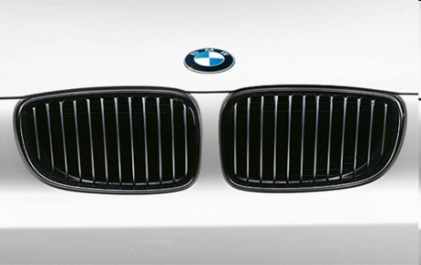
Registered Design - Examples
Car body shapes are good examples of Registered Designs. Manufacturers want to stop other companies copying successfully styled cars, even if the technology inside the car is too similar to the previous models to be able to patent them. Distinctive features such as radiator grills can be protected as well as the overall body shape.

Slide 43
Registered Design - Process
The process for registering a design is similar to that for obtaining a patent and is also controlled by the Patent Office.
The design has to be kept confidential before the application is filed, and then a search is carried out to see if there is any previous work that is similar.
If the search does not show up any possible conflicts, the design is granted its Registration.

Slide 44
Registered Design - Process
Once granted, the registration can be kept for 25 years, as long as renewal fees are paid.
If the company does not feel it is worth spending the money as the product’s life cycle nears its end, they may allow its registration to lapse.
This enables competitors to begin copying the design legally.

Slide 45
Patent
The first patent was granted in 1449, to John Utynam, who wanted to protect his method for making stained glass.
He was granted a monopoly on the process for 20 years by the King, in the form of an open letter.
This was the method before the Patent Office was opened in London in 1852. Nowadays, over 30,000 patents are applied for each year.

Slide 46
Patent
If you own the patent on a product you will have exclusive design rights on it for up to 20 years.
However, as part of the process the patent is made available to the public for any interested parties, including competitors, to see.

Slide 47
Patent
This has two results:
competitors can keep an eye on what the opposition are working on and see which way the market may be going;
65% of research and development (R&D) has been done before and is available for viewing in the Patents Library. This can save vast sums of money in R&D budgets.
The main aim of this process is to encourage innovation.

Slide 48
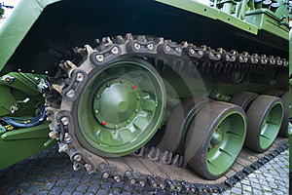
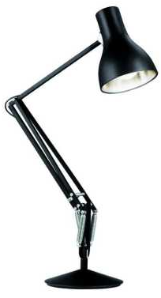
Patent - Examples
Tracks: Tanks and diggers are fitted with tracks which enable them to travel over soft ground without them sinking and becoming stuck. The first use of tanks was at the Battle of Cambrai in 1916, during WW1, and most people think that this was the first time that tracks had been used. In fact the first patent for such devices was issued in 1770!
A famous example of a successful patent is the Anglepoise lamp. This was developed in the 1930s, and is still used worldwide today.

Slide 49
Patent - Process
Patents do not have to be maintained for 20 years. They can be allowed to lapse by not paying renewal fees which arise annually after the 4th year. If the patent lapses your competitors may start using your idea.
Have an idea
Keep it confidential whilst you develop the idea
File a Patent Application at the Patent Office
Search for existing, similar ideas
Application published with search report
Examination
Patent granted
Renewals

Slide 50
Task 3
Find one product in your kitchen that is patented.
What do new products have marked on them if sold before a patent is finally granted?
Find one of the above.
Try to find the approximate cost of a patent being awarded for 20 years.
a) Conduct an internet search to find Espacenet (www.espacenet), and then search for patents on products that interest you, or relate to current project work. b) Could you improve any of the products that you have found during your search? If so, how?

Slide 51
Task 4
Some examples of famous inventions that have been patented are shown below in the table. Try to fill in the gaps:
Product | Inventor | Year
Cats-eye road stud
Workmate folding bench
Electric light bulb
Anglepoise lamp
Pneumatic tyre

Slide 52
Task 4 - Answers
Some examples of famous inventions that have been patented are shown below in the table. Try to fill in the gaps:
Product | Inventor | Year
Cats-eye road stud | Percy Shaw | 1934
Workmate folding bench | Ron Hickman | 1961
Electric light bulb | Humphrey Davy | 1802
Anglepoise lamp | George Carwardine | 1933
Pneumatic tyre | John Dunlop | 1887

Slide 53
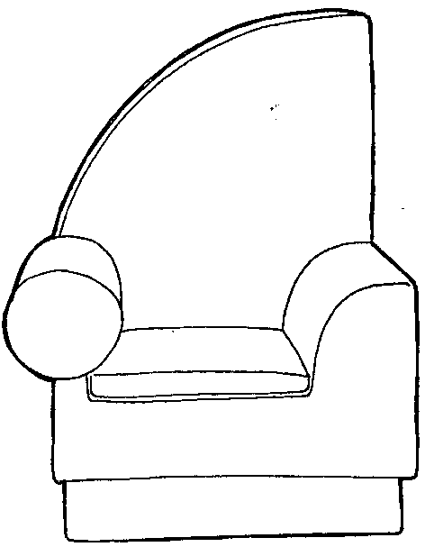
Product Design
Fashion and Style
Alternative Link
http://prezi.com/b-dcpd2hst5y/fashion-style-fad/?auth_key=10daebab05fa839258dea0f0c9cbe541bf83ca6a

Slide 54
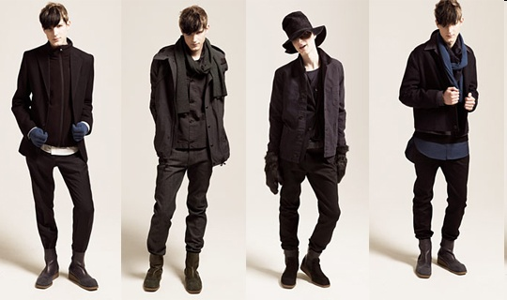
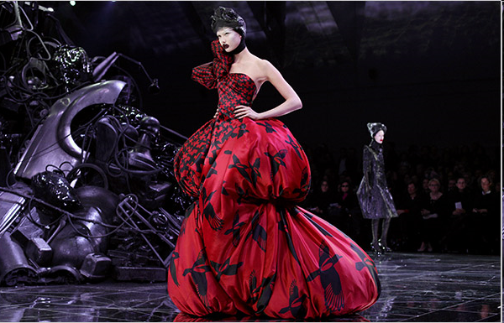
Fashion
Something that is current and popular with the buying public.
First, a small number of consumers will take an interest in the design because they feel it sets them apart from everyone else (leaders of fashion are often TV celebrities, pop stars or sporting personalities).
After some time the fashion will become mainstream when the major manufacturers adapt the design for the high street.
Finally the fashion begins to fade in popularity as the consumers move on to the next ‘must have’ design.

Slide 55
Task
Write down three examples of products that are fashionable at this time.
Why?

Slide 56
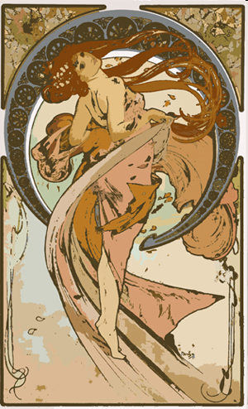
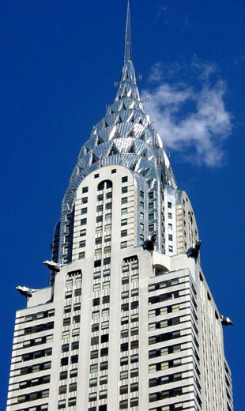
Style
A style is more distinctive and can be classed as a form of expression. Throughout design history there have been very distinctive styles that can be linked to a period in time.
Victorian 1830s-1890
Art Nouveau 1890-1905
Art Deco 1925-1939
Pop Art 1960s

Slide 57
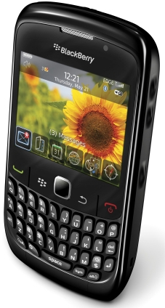
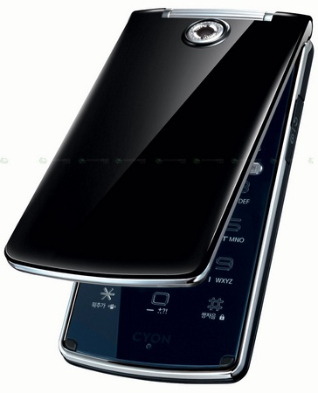
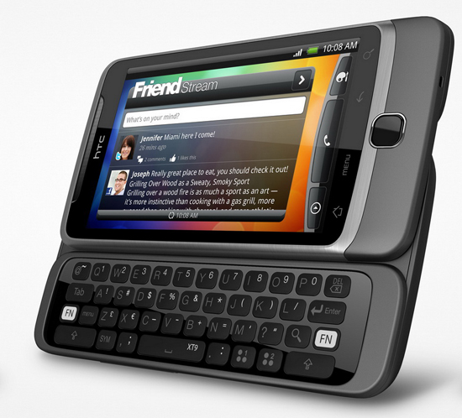
Style of Mobile Phone
Candy bar (brick)
Clam shell (flip)
Sliding (flick)
Touchscreen
\\\

Slide 58
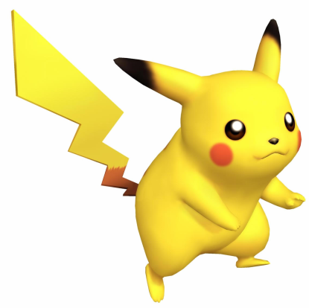
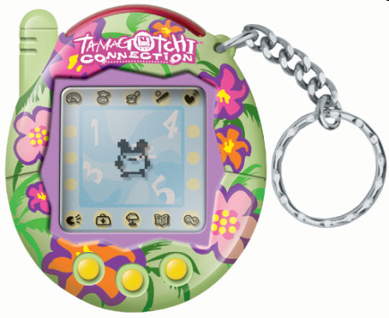
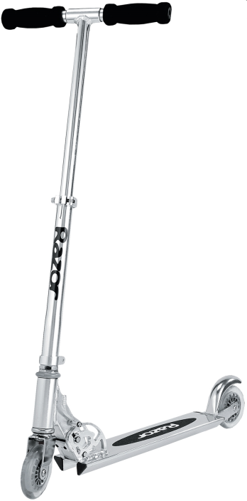
Fad/Craze
A product that becomes fashionable very quickly and is adopted with great enthusiasm by certain market groups and declines in popularity after a short time.
Young people in particular are attracted to this type of product.
Do not fulfil any real need or offer any benefit to the consumer.

Slide 59
Typical Life Cycle
The following illustrations give an indication of how the life cycle of a product might appear if it were an item of style, fashion or just a fad.

Slide 60
Conclusion
FASHION
A fashion is something that is current and popular with the buying public.
STYLE
A style is more distinctive and can be classed as a form of expression. A style will have recognisable features.
FAD / CRAZE
The term fad denotes a product that becomes fashionable very quickly and is adopted with great enthusiasm. Fads do not survive long because they do not fulfil any real need or offer any benefit to the consumer

