Slide 1
Construction Drawings for Graphic Communication
A building or construction project requires a complete set of specialised drawings. These drawings are known as a Project Set. The following plans are found in a project set:
Location Plan
Site Plan
Floor plan

Slide 2
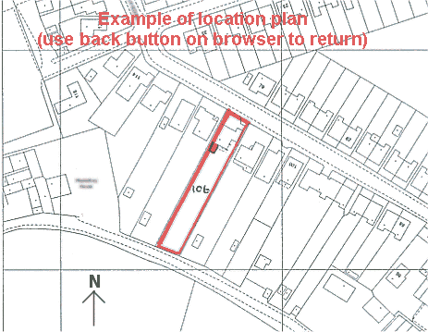
Construction Drawings for Graphic Communication
Location Plan
Scale 1:1250
The Location Plan is the first drawing in the project set.
The location Plan identifies the location of the proposed new building within its surroundings.
The Location plan shows:
neighbouring buildings, roads, street names and fields
Direction arrow – Always indicates North
The proposed building and plot are outlined in thick lines.

Slide 3
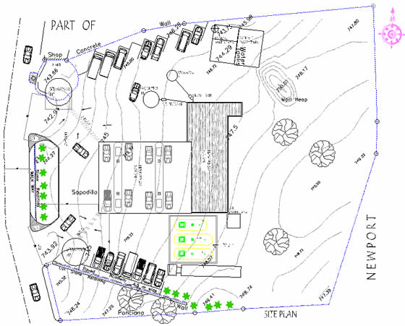
Construction Drawings for Graphic Communication
Site plan Scale 1: 200
Shows the boundary and the outline of the new building
Plots, roads and neighbouring plots are also shown.
Existing tree, manholes and contour lines can also be found in this site plan.
Site plans can also show the position of the house on the site and dimensions of the house and site area.

Slide 4
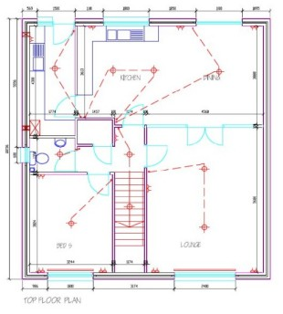
Construction Drawings for Graphic Communication
Floor plan Scale 1: 50
Plan view which helps to show:
- The arrangement of the rooms
- The position of windows and doors
- Types of internal and external walls
Detailed floor plans also show the layout of kitchens and bathrooms, BSI symbols are used for these.
Electrical, plumbing and heating features are also detailed.

