Slide 1
Computer – Aided Design
Terminology
You must have a generic understanding of commands and techniques which are used in a number of packages (YOU CANNOT BE SOFTWARE SPECIFIC)
You MUST use the correct terminology in the exam, you WILL NOT be given marks in an exam for using software specific terminology.

Slide 2
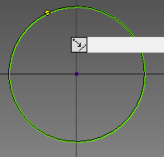
Computer – Aided Design
Drawing Tools
The LINE tool creates lines within a drawing.
- The CIRCLE tool creates a circle either using a centre point and radius.
- The RECTANGLE tool creates a rectangle.
- The ELLIPSE tool creates an ellipse using a centre point and major and
minor axis.
- The TRIM tool trims a curve or straight line to the nearest intersecting curve
or selected boundary.

Slide 3
Computer – Aided Design
Drawing Tools
COPY Allows a drawing or part of a drawing to be copied and placed in another area of the drawing or within another file.
ZOOM Allows the operator to zoom into specific areas of a drawing, this helps when doing detailed work.
ROTATE Allows the operator to rotate any aspect or part of a drawing to a specific angle.
SCALE Allows the operator to scale a drawing up or down as required without loss of quality.
IMPORT AND EXPORT Allows for items to be imported exported from software compatible programmes. e.g . Pictures can be imported into CAG programmes.

Slide 4
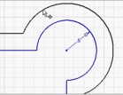
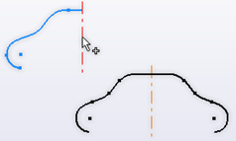
Computer – Aided Design
Drawing Tools
The ARRAY tool (Linear ,Radial and Rectangular): Duplicates selected sketch
geometry and arranges it in rows and columns. Or in an arc or circle in the
case of the radial array. Can also be used in a 3D model context
- The OFFSET tool duplicates selected sketch geometry and dynamically
offsets it from the original.
The MIRROR tool creates a mirrored copy of a sketch across an axis. Can also
be used in a 3D model context.
- The EXTEND tool extends a curve or line to the next intersecting line or
curve.

Slide 5
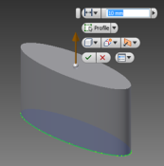
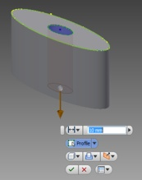
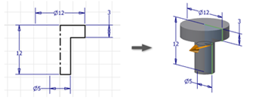
Computer – Aided Design
Modelling Features
EXTRUDE ( Add) creates a feature or body by adding material.
EXTRUDE (Subtract) removes material from a part or assembly
- REVOLVE creates a body by revolving one or more profiles around a
given axis.

Slide 6
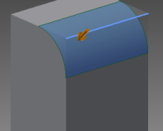
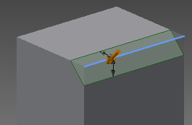
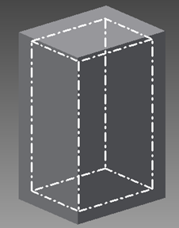
Computer – Aided Design
Modelling Edits
FILLET adds fillets or rounds to one or more edges or faces.
Can also be used in the 2D drawing tools.
CHAMFER adds fillets or rounds to one or more edges or faces. Can also be used in 2D drawing tools
SHELL Removes material from a part interior, creating a hollow cavity with walls of a specified size.

Slide 7
Computer – Aided Design
Modelling Terms
MODELLING TREE: The linear hierarchy of how a 3D CAD model is created or assembled.
ASSEMBLY: An assembly of separate components.
SUB ASSEMBLY: An assembly of components that is added to another, larger assembly.

Slide 8
Computer – Aided Design
Constraints
MATE: To join the face of a 3D model to another face.
ALIGN: To align the face of a 3D model with another face.
CENTRE AXIS: To find the centres of cylindrical 3D CAD models and align them.
COMPONENT: A single component part, used to create an assembly later on.
SKETCH: The name given to the CAD drawing feature used to create a profile.
CAD LIBRARY: A directory of commonly used parts.

Slide 9
Computer – Aided Design
Model Types
SOLID MODEL: Made up of solid shapes and materials added or subtracted as necessary.
SURFACE MODEL: The construction of surface model is done with the use of geometric entities like surfaces and curves. Surface Modelling uses splines and Bezier mathematical techniques for controlling curves
WIRE FRAME MODEL: A wireframe model represents the shape of a solid object with its characteristic lines and points

