Slide 1
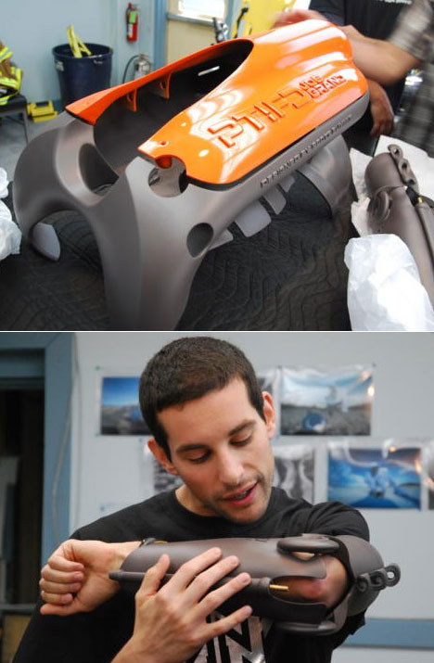
Model Making in Design
Model making plays a vital role in the process of designing. At every stage of design, from conception to completion, the construction of three dimensional models provides the student/designer with the mechanism to clarify and to develop their ideas and, just as importantly to convey these ideas to their colleagues in the design development team.

Slide 2
Model Making in Design
So models can be used to:
develop ideas
evaluate and test ideas and design issues
communicate ideas
Designers produce a variety of types of models, each with a specific purpose. It must be made clear why and when models are made, how the operate in conjunction with other design techniques and the variety of materials which can be used for modelling.

Slide 3
What is a Model Used For?
It is more effective at communicating ideas than a drawing, because it is tangible, an object's size, form, surface, texture, colour, finish, and even its weight and balance can all be assessed from the model. The model
It allows a designer to experiment with different ideas before going to the expense of manufacturing the final product.

Slide 4
Types of Model
There are several different types of models often with more than one name. The following is a list of different types of models used:
Simple Sketch Models
Block Models
Scale Models
Ergonomic Test Rigs
Presentation/Appearance Models
3D CAD Models
Rapid Prototyping
Production Prototyping

Slide 5
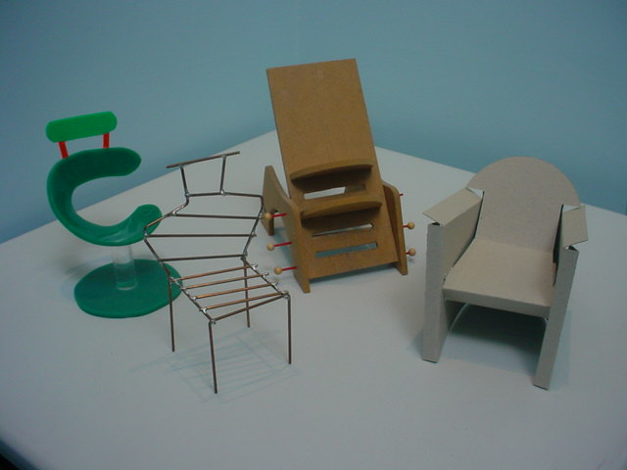
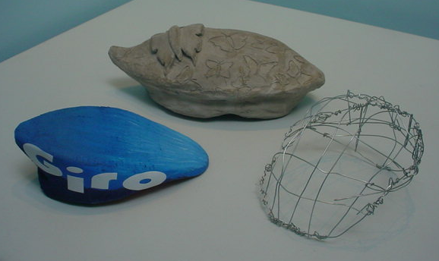
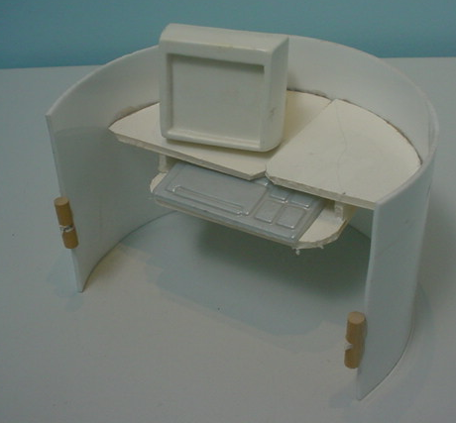
Simple Sketch Models
Simple Sketch Models are used for testing numerous ideas early on in the design process. This is the simplest, cheapest and quickest way of evaluating many ideas for form, technical arrangement and usability but highly under-utilised.
These are made from a variety of materials such as card, clay, polystyrene, balsa, wire, plaster of Paris, blocks of wood. These models are developed like 3D sketches

Slide 6
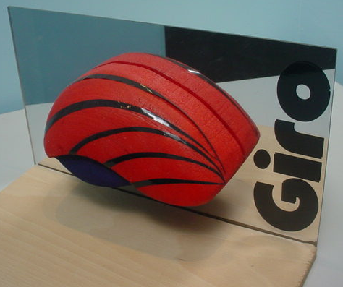
Block Models
Block Models are primarily for early testing of usability, ergonomics and form. They are useful to quickly evaluate a product's physical arrangement. Models can be made out of paper, card, foam, wood or other easy to work and cheap materials.

Slide 7
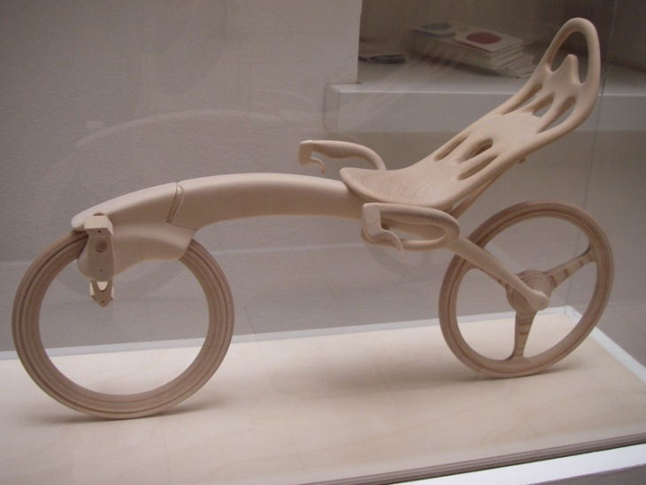
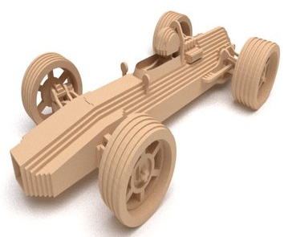
Scale Models
It can be difficult time-consuming and expensive to produce full size models, and in the case of architecture and interior design, impossible. For these reasons scale models are used to develop ideas or convey them to clients. Scale models must be carefully constructed so that the length, width and thickness of the parts are accurately represented

Slide 8
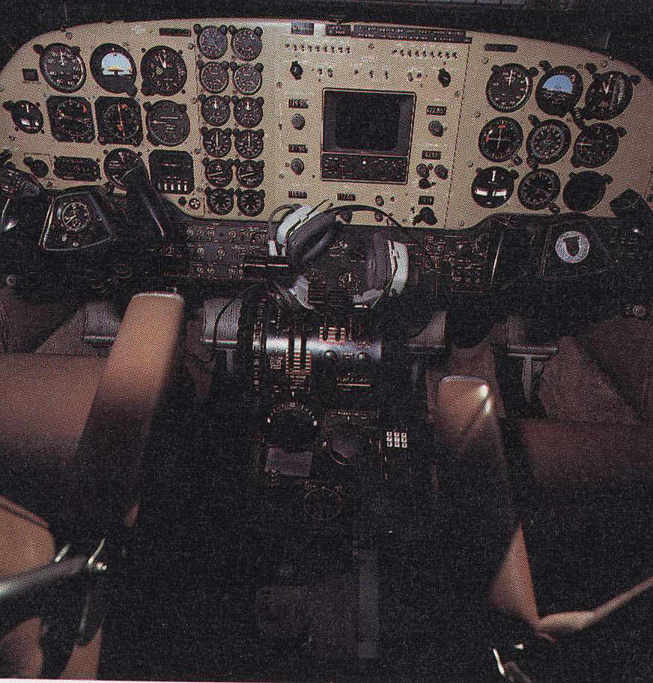
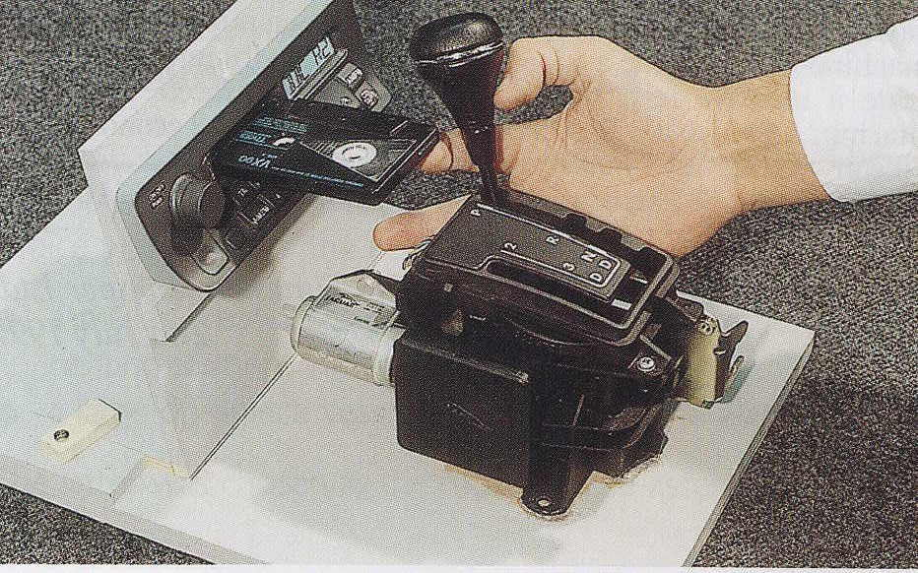
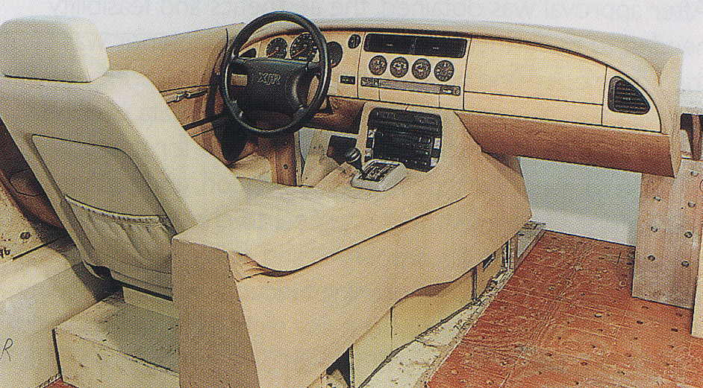
Ergonomic Test Rigs
Ergonomic test rigs are often constructed to test factors such as strength and ergonomics or to evaluate the feasibility of a new mechanism. The use of test rigs is often vital to the eventual success of the project.

Slide 9
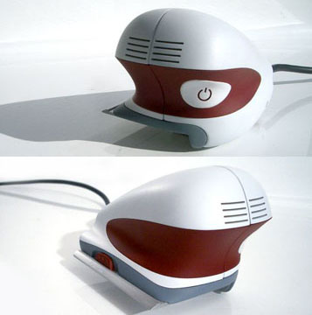
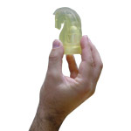
Presentation/Appearance Models
Used to enable evaluation of visual and form aspects. They are produced to look as realistic as possible and are good for testing product feel and form. Presentation models are ideal for use in focus groups, trade shows and other sales and marketing activities.

Slide 10
Presentation/Appearance Models
These models demonstrate the final appearance of the design in every visual detail. Although it looks like the real thing the finished model will not work.

Slide 11
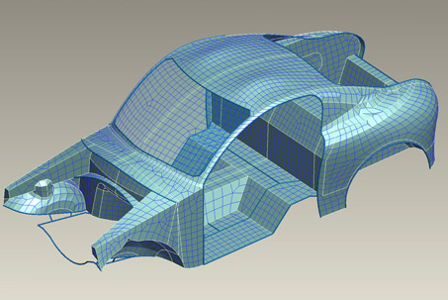
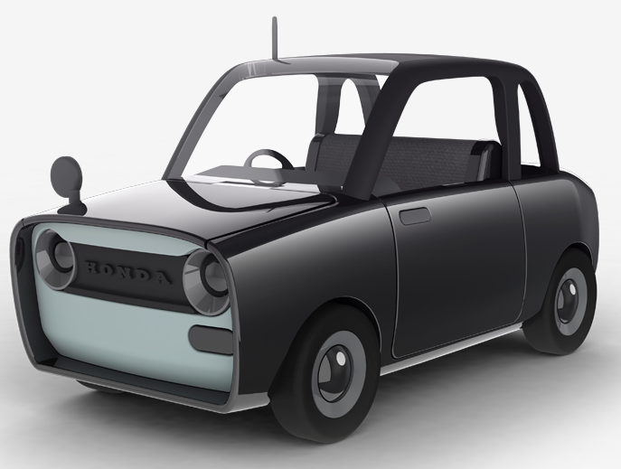
3D CAD Models
The appearance of 3-dimensional objects can be generated on a computer as a substitute for physical models or drawings. Images can be coloured, textured, and rotated so that the design can be viewed from any angle.

Slide 12
3D CAD Models
3D CAD models are used to evaluate overall form, assembly sequence and production issues. And are often photo realistic. They are excellent to gain support and buy in from senior management but again there is a danger of thinking that the product is 'finished'.

Slide 13
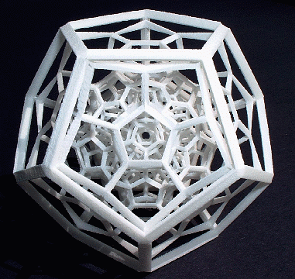
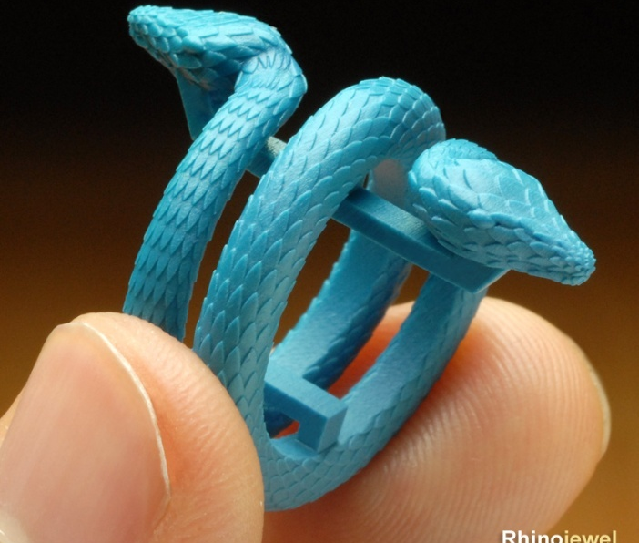
Rapid Prototyping
Rapid Prototyping is an "additive" process, combining layers of paper, wax, or plastic to create a solid object.

Slide 14
Rapid Prototyping
In contrast to most machining processes i.e. milling, drilling, grinding, which are "subtractive" processes that remove material from a solid block. RP’s additive nature allows it to create objects with complicated internal features that cannot be manufactured by other means.

Slide 15
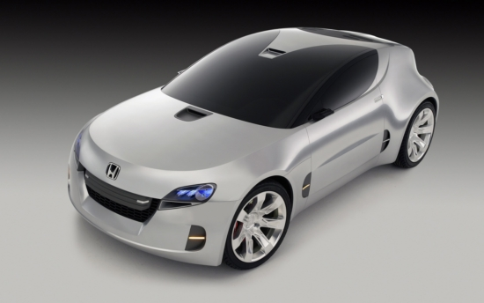
Production Prototyping
Production Prototypes are full-scale models, virtually indistinguishable from the design outcome.

Slide 16
Production Prototyping
They are fully working models, which are as close to the final product as possible; they are "one-offs" made by hand before the decision is made to manufacture the product they are used to evaluate performance, function, form and use.

Slide 17
The table below illustrates how cost and reliability relate to the different types of model:
Type of model | Function/Performance | Appearance | Manufacturability | Usability | Cost
Sketch Model | Low | Low/medium | Low | Low | Low
Block Model | Medium | Medium/High | Medium | Medium/High | Low/Medium
Scale Model | Low | Medium/High | High | Medium | Medium/High
Ergonomic Test Rig | High | Low | High | High | High
Presentation or Appearance Model | High | High | High | Medium/High | High
3D CAD Model | Medium | High | Medium/High | Low | Low
Rapid Prototyping | Low | High | High | High | High
Production Prototype | High | High | High | High | High

Slide 18
Things to think about
Why are you making a model ?
What do you want the model to achieve ?
Who is the model for – you, client or your colleagues ?
Is making a model the most appropriate way to achieve your goal ?
Would a sketch or drawing be quicker, cheaper or more effective ?
What scale should it be ?
What are the most appropriate materials for the model and why ?
Are there any special skills or tools required to use the selected materials ?
Does the model need a high standard of finish ?
How will the model be used after it’s completion ?
How can you use the model to develop your design ?
How can you use 2-D sketches and drawings to develop 3-D models ?
Should you photograph the models in case they deteriorate ?

Slide 19
Conclusions
The reliability of a model can be defined as how accurately the model represents either functionality (or performance), appearance, manufacturability or usability. A model with high reliability will closely imitate the characteristics of the final production item. There is a trade off between reliability and cost, typically, the greater the reliability, the higher the cost.

Slide 20
Revision
Write down 3 different types of model that could be used by a designer when developing a new product. Discuss the advantages of each of these models.
Describe where and why a designer would use Styrofoam to model in preference to a solid material.

