Slide 1
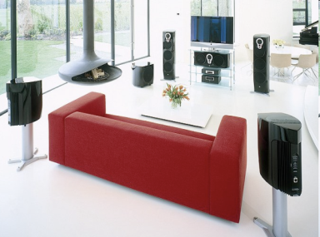
Social Expectations
People’s tastes differ. While this statement is true and each person can be regarded as an individual, on a global scale designers treat people as groups or segments differentiated by such factors as cultural differences, religious beliefs, lifestyle and age.
They will design products for a particular market segment according to that group’s perceived needs or wants.

Slide 2
Social Expectations
Lifestyle is a huge factor in the type of products now being designed.
People’s lifestyles have changed remarkably, especially since the 1950s. Post-war affluence has allowed more people to own a variety of different products.
“There was a strange moment around the mid 1960s when people stopped needing and started wanting…” Terence Conran

Slide 3
Social Expectations
Designer must consider changing patterns of social behaviour when working on new products.
Aspects considered important in the design of products 50 years ago may not be seen as critical today.
Washing machines, microwave ovens and hairdryers are no longer considered a luxury; they are now felt to be essential.

Slide 4
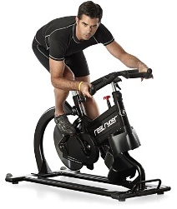
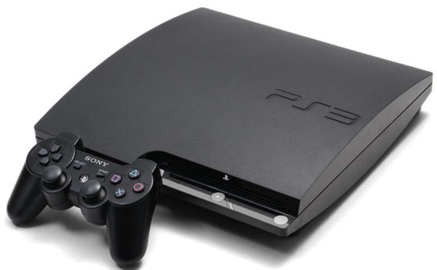
Social Expectations
People find themselves with more time on their hands. Working from home, longer holidays, shorter working hours.
Increased demand for; entertainment such as music systems, DVD’s, Blu Rays and home cinema; DIY and gardening related products; gym memberships and home exercise machines.

Slide 5
Social Expectations
Design and product development is now a part of most company business plans.
The type and nature of the products developed must reflect the market niche’s lifestyle and wants.
Influenced by fashion, local customs, topical issues and changes in the law, for example in 2002 the UK the car tax rules changed which resulted in a huge growth in sales of diesel fuelled company cars.

Slide 6
Niche Marketing
Identifying a group of customers and targeting a product to meet their specific needs.
If a manufacturer identifies a new niche and is the first to develop a product then they will have a monopoly in sales and will achieve 100% market share.

Slide 7
Niche Marketing
Most manufacturers, whether big or small, carefully target particular market niches in order to maximise sales.
HP, for example, markets all-in-one machines that print, fax and scan to segments of the home office market, while targeting larger businesses for higher-priced, single-function units.

Slide 8
Niche Marketing
Can be extremely cost-effective.
For instance, a manufacturer may target the product to a particular demographic group, such as teenagers.
The company could advertise on radio or TV stations, which have considerably lower rates than those which cater for broader audiences.
The marketing budget would go a lot further, allowing the manufacturer to advertise with greater frequency or to use a more comprehensive media mix.

Slide 9
Niche Marketing
Can be a low-risk way to grow a business, as long as the company follows the three basis rules:
Meet the customers’ unique needs
Say the right thing
Always test-market

Slide 10
Niche Marketing
It is not always a good sign if there is no competition in a market, it could mean that other companies have not found the key to providing a product this niche will buy.
It could also be that other companies have tried and failed to penetrate this segment.
Manufacturers should always test-market carefully to gauge the customers’ reaction to the product or service and their message.

Slide 11
Market Research
Selecting the correct market segment to aim a product at is vital to its economic success.
Before making such a decision a company will carryout market research to see:
Whether the total market for a particular product is growing, static or declining;
What changes are taking place in the market where the product will compete;
What do the customers want and need from the product;
Who the main competitors are in the market segment.

Slide 12
Market Research
Market research is a means of trying to reduce the risk and uncertainty surrounding the development of a new product.
There are two basic types of market research:
Field
Desk.

Slide 13
Market Research
FIELD (PRIMARY) RESEARCH
Experiments: such as demonstrating products to a focus group
Audits: a check of product stock in shops and analysing sales figures.
Observation: noting how people use a product and any difficulties they may encounter.
Recording: counting how often consumers use a specific product over a set time.
Surveys: interaction with specific market groups through questionnaires, individual interviews and focus group work.

Slide 14
Market Research
DESK (SECONDARY) RESEARCH
External sources: reports, newspapers, journals, media reports and government audits.
Internal sources: accounts and sales records.

Slide 15
Market Research
DESK RESEARCH
Can provide general information on the needs and wants of the consumers
Who already sells in that market segment.
Inexpensive and quicker to conduct than field research,
Disadvantage that any figures are based on past performance which is not necessarily an accurate way of predicting future trends
Much of this information will be publicly available and may be used by competitors.

Slide 16
Defining the Market
Described as the set of potential buyers for a product or service.
The size of the market will depend on the number of buyers for a particular product.
Potential buyers for a product will have three things in common: interest, income and access.

Slide 17
Defining the Market
Potential market – number of people who have some level of interest in the product.
Available market – consumers who have and interest in the product, have the income to afford it and access to buy.

Slide 18
Defining the Market
Qualified available market – age restrictions etc.
Served market -who to target (after qualified market)
Penetrated market – those that already own the product

Slide 19
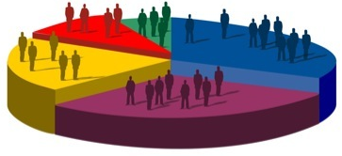
Market Segments
Few products can be said to complete in the global market. Most companies use target marketing to direct products at one or more group of consumers who share the same needs and wants.
Market segments can be thought of as groups of people who have something in common that will affect their choice of product.

Slide 20
Market Segments
There are many ways to define a particular market group but generally they can be grouped into four categories:
GEOGRAPHIC: countries, regions, cities
DEMOGRAPHIC: age, sex, income, education, race
PSYCHOGRAPHIC: personality, lifestyle, social class.
BEHAVIOURISTIC: purchase frequency, usage, benefits sought, brand loyalty.

Slide 21
Market Segments
Each of these market segments (GEOGRAPHIC, DEMOGRAPHIC, PSYCHOGRAPHIC, BEHAVIOURISTIC) can be broken down further and products can be targeted at a much narrower group of people.

Slide 22
Market Segments
For example, age can be used to divide the population into six segments:
5 to 10 years: this age group could be classified as fun years
11 to 17 years: these are often fashion driven years
18 to 25: most people become independent.
26 to 35: many people are motivated by their career
36 to 55: often family becomes the major priority
56 +: this is a time when more choice is available.

Slide 23
Marketing Mix
The marketing mix consists of everything that can be done to influence the demand for the product.

Slide 24
Marketing Mix
Known as a the “Four P’s”
Product: anything that can be offered to the market in order to satisfy a want or need.
Price: the amount charged by the company or exchanged by the consumer for a product.
Place: all the company’s activities that make the product available to the consumer.
Promotion: any activity which will advertise the product and its benefits to potential buyers.

Slide 25
Marketing Mix
Product
Product range
Standards
Style
Features
Guarantee
Packaging
Services
Price
Product price
Reductions
Allowances
Payment terms
Credit agreements
Place
Retail outlets
Market breadth
Transportation
Location of outlets
Promotion
Good advertising
Promotion strategy
Selling strategy
Public image
Target Market (Consumers)

Slide 26
Marketing Mix
CONSUMER BENEFITS
Product: the consumer’s wants and needs are met by the product.
Price: the cost to the consumer is affordable and competitive
Place: the product is accessible to the consumer to buy.
Promotion: the product should appeal to the consumer.

Slide 27
Marketing & Sales
Today’s market requires a more sophisticated approach and all successful manufacturers spend a lot time and money informing the public about their product and persuading us to buy it (about 5% of the price of a new car is spent on marketing).

Slide 28
Marketing & Sales
Marketing begins early in the design process by seeing what the customer wants/needs using questionnaires or focus groups.
Some manufacturers carryout this market research themselves, but most use specialised organisations such as Mori.
Here the key to accurate market research is in the balance of the sample group (age, gender, family, social class, education and income), rather than its overall size.

Slide 29
Marketing & Sales
Effective marketing is about creating a positive image for the product (and company) by associating it with the lifestyle and aspirations of the target market.

Slide 30
Marketing & Sales
A marketing campaign may use some or all of the following marketing tools:
ADVERTISING - to create awareness and help establish a positive image.
SALES PROMOTIONS – these can add value (three for the price of two), or promote the product at the point of sale.
PUBLIC RELATIONS (PR) – here the company will try to get as much free publicity as possible; regular press releases designed to get journalists to talk (write) about the product, celebrity endorsements and special events.
SPONSORSHIP – of art & sporting events, which are associated with the potential interest of the target market.
DIRECT MARKETING – tailoring the message to the customer using databases, either compiled from existing customers (from returned guarantee cards) or bought from specialised companies, to help target the mail shots.

Slide 31
Aesthetics
Concerned with how an object affects our senses visually.
A product will normally be evaluated at the end of the design process but initial reactions will be based on its aesthetics (how it looks).

Slide 32
Aesthetics
First impressions count; so designers must consider aesthetics when developing a product in order to maximise sales.
Like colour, form plays a major part in product design.

Slide 33
Aesthetics
Aesthetics takes into account a whole range of factors such as:
Material
Shape
Light
Contrast
Line
AESTHETICS
Colour
Pattern
Harmony
Proportion
Form
Texture

Slide 34
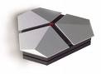
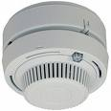
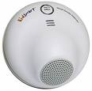

Slide 35
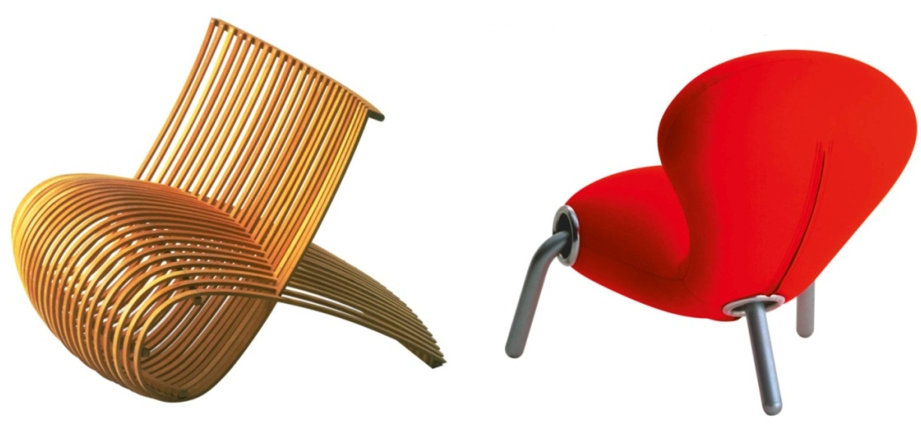
Aesthetics
Certain shapes, particularly those based on the human body, can affect us in certain ways. This is because these shapes often relate to our most primitive feelings. Likewise, colours can affect us; experiments have shown that a red room will raise our blood pressure while a green room will lower it.

Slide 36
Contrast & Harmony
The most dynamic of visual features. This is where different parts of a product are compared, any differences are made clear.
Contrast can be made using shape, size, colour, texture, pattern etc

Slide 37
Contrast and Harmony
Conversely the previous elements can be used to unite parts to create a harmonious design.

Slide 38
Proportion
Proportion concerns the relationship between one size and another.
Generally if something looks right then its proportions will be right.
Proportion can be used to balance, contrast or highlight different areas of a design.

Slide 39
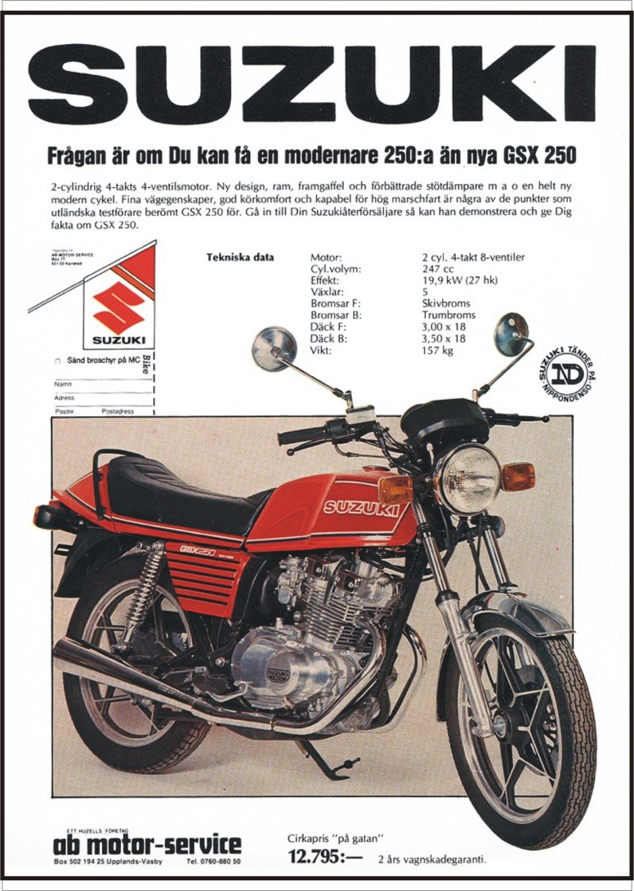
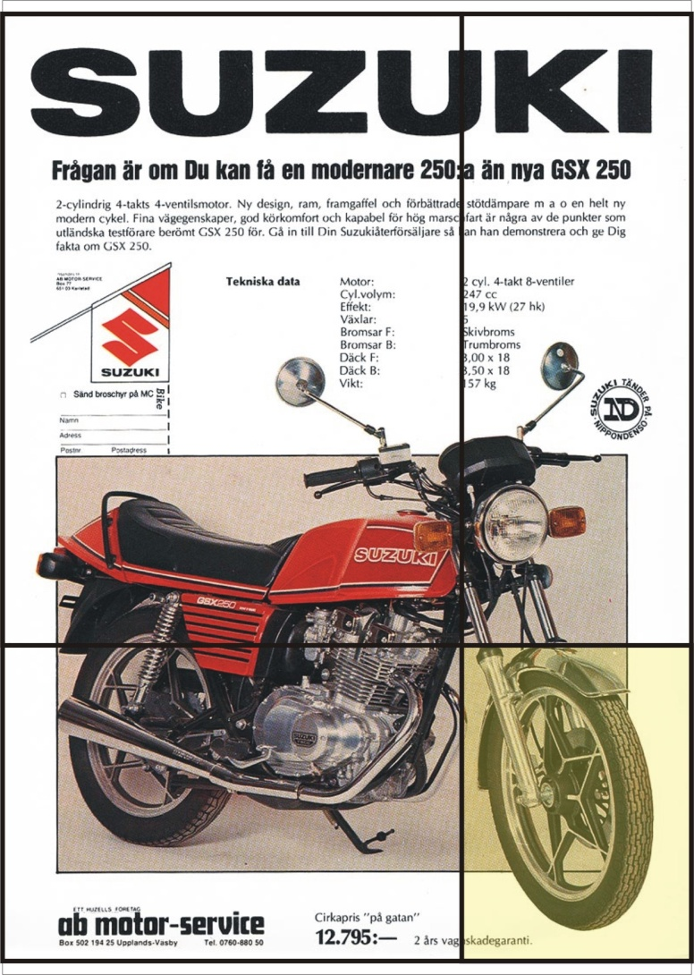
Proportion
“Golden Section”

Slide 40
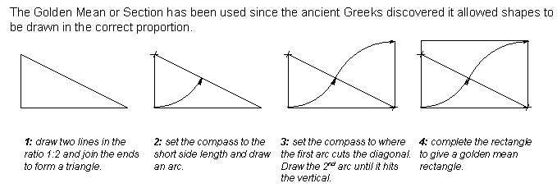
Golden Mean Rectangle
The Golden Mean has been used since the Ancient Greeks discovered it allowed shapes to be drawn in the correct proportion.

Slide 41
Fibonacci Series

Slide 42
Symmetric and Asymmetric
In an asymmetric object such as the one shown below, the large difference in size between the two surfaces creates a contrasting effect where one area is highlighted against the other. This can give the design a dynamic look.
The Balanced symmetrical composition shown on the right gives the impression of stability and order.

Slide 43
Balance and Movement
Horizontal and Vertical line = balance
Sloping Lines = unstable unless supported
Changing it to a curve implies balance on a vertical line.

Slide 44
Balance and Movement
Position and characteristics affect balance and movement.
stable
unstable
dynamic

Slide 45
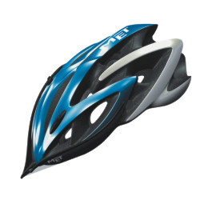
Balance and Movement
Position and characteristics affect balance and movement.

Slide 46
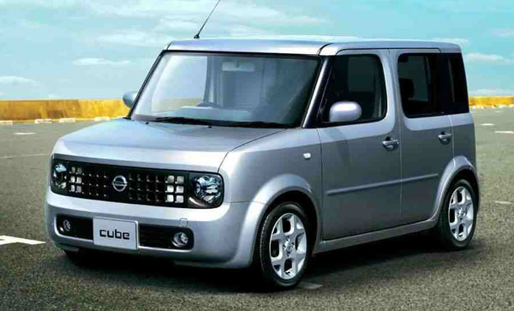
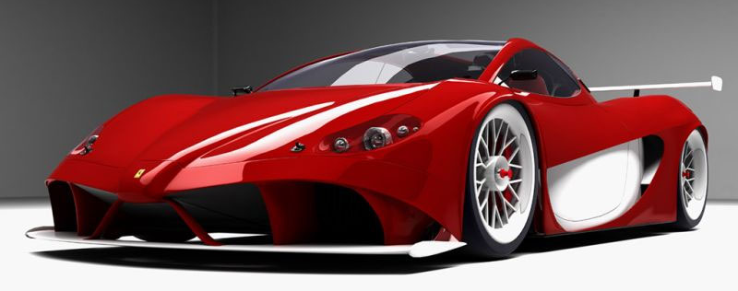
Balance and Movement
Position and characteristics affect balance and movement.

Slide 47
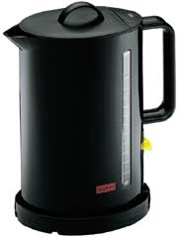
Task - Two Kettles
Compare the two kettles using some of the terms in today’s and previous lessons

Slide 48
Colour
Integral part of the design process that is too often neglected.
The psychology associated with colour can influence how we react to a product.
For example, the combination of black and yellow suggests danger and is often used in warning signs.

Slide 49
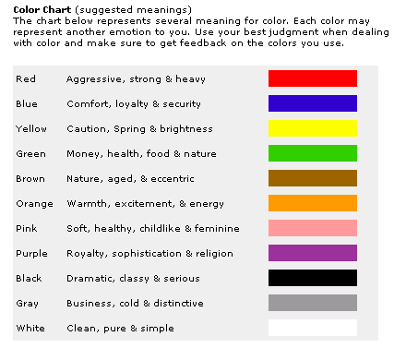

Slide 50
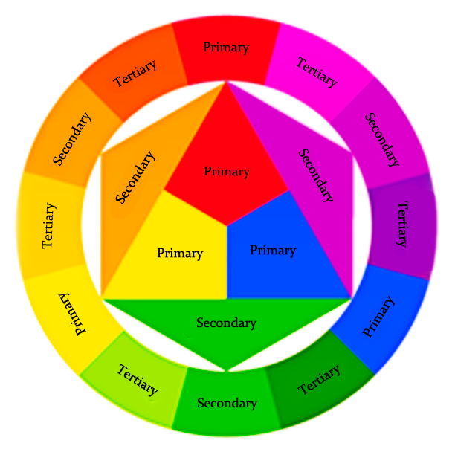
Colour Wheel
A useful tool when considering colour is the colour wheel.

Slide 51
Colour Wheel
Primary Colours
Red
Blue
Yellow
Red
Yellow
Blue

Slide 52
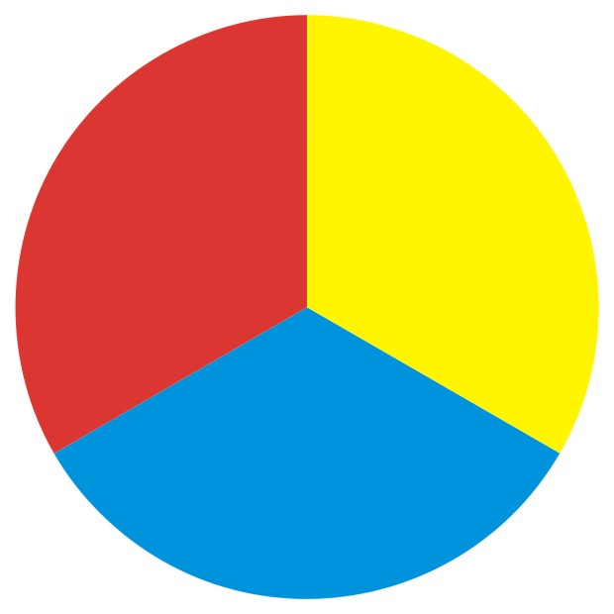
Colour Wheel
Secondary Colours
Made by mixing Primary Colours
Orange
Violet/Purple
Green
Red
Red
Red
Orange
Red
Yellow
Yellow
Yellow
Violet
Yellow
Blue
Blue
Green
Blue
Blue

Slide 53
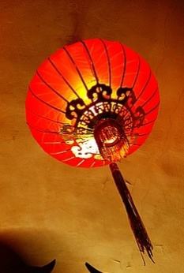
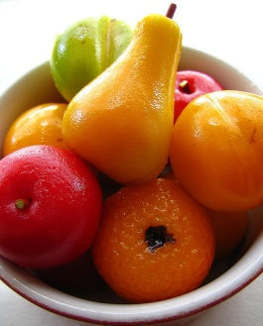
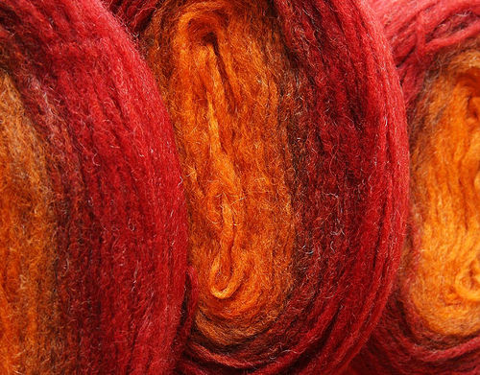
Warm Colours
Reds, Yellows, Oranges and their derivatives are WARM colours. This means that they give feelings of warmth.
They are also known as ADVANCING Colours because they tend to come towards you, or feel closer to you, and come forward in a picture.
Ex – a room painted with warm colours would feel warm but also the room would feel smaller as the warm colours make the walls look closer.

Slide 54
Cool Colours
Blues, greens, violets and their derivatives are COOL colours. This means that they give feelings of coldness.
They are also known as RECEDING colours because tend to go away from you, or feel distant to you, and recede in a painting.
Ex – a room painted with these colours would feel cold but also make the room feel bigger as the cool colours make the walls look more distant.

Slide 55
Harmonising Colours
When colours close to each other on the Colour Wheel are used in DESIGN.
Easy on the eye. Creates a relaxing image.

Slide 56
Contrasting Colours
When colours on opposite ends of the Colour Wheel are used in DESIGN.
Varying balance between colours creates different effects.

Slide 57
Aesthetics: Case Studies
Choose any product that you feel could have been chosen for its aesthetic properties. Discuss the features of the product with regard to the items listed below. (Use sketches to illustrate your product.)
Line Shape (2D) Form (3D) Proportion Contrast Harmony Pattern Texture Material Colour Light

Slide 58
Ergonomics
The study of how humans interact with their environment and the products they use.
The science of designing the job, equipment, and workplace to fit the worker.
Necessary to prevent repetitive strain injuries, which can develop over time and can lead to long-term disability.
Alternative link:
http://prezi.com/7nhchhj9rzf7/present/?auth_key=gzp8hh9&follow=nglbjimbfy5o

Slide 59
Ergonomics
Ergonomics can be sub-divided into three main areas:
Ergonomics
Anthropometrics
Physiology
Psychology

Slide 60
Ergonomics - Anthropometrics
Involves the measurements of the human body. A survey is made of around 1 million people between the ages of about 19 – 65 with every relevant part of the body being recorded.
This information is then compiled to make charts called ‘Anthropometric data tables’ which show us what the smallest, largest and average sizes are.

Slide 61
Designers only use information from the 5th to the 95th percentile.
They want to be able to cater for as many people as possible.
People from the 0 – 5 percentile and those from the 96th – 100th percentile are seen as being too extreme, i.e. too small and too big.

Slide 62
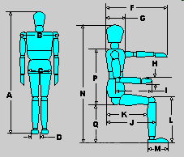
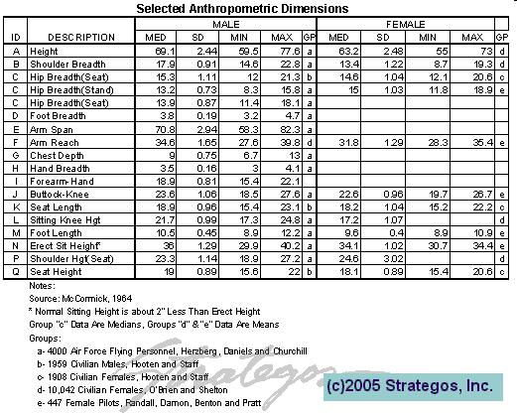
Ergonomics - Anthropometrics

Slide 63
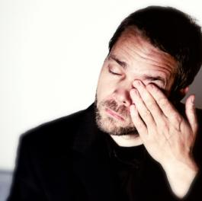
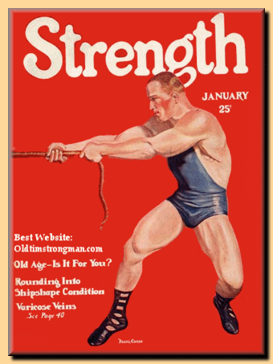
Ergonomics - Physiology
The study of the systems within the human body, their responses, limitations and capabilities.
Designers may have to consider strength, fatigue, muscle control, colour perception, hearing capabilities and other features when designing for people.

Slide 64
Ergonomics - Physiology
For example, when designing the braking system for a car it must be able to be operated effectively by all drivers. Anthropometric information must therefore be gathered about the strength of people’s legs, as well as on lever and hydraulic systems designed to suit the forces required.
The legs are used for the repetitive tasks in driving such as applying the brakes and the clutch because they are much stronger than arms and hands, which are more nimble and better suited to finer controls like using the steering wheel or adjusting the volume on the radio.

Slide 65
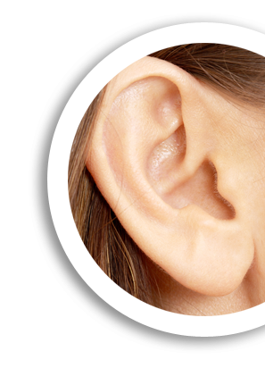
Ergonomics - Psychology
Psychology is concerned with the human mind and the way it works. Human senses (sight, hearing, smell, touch, taste) are continually being stimulated and send messages to the brain where they are processed. Some signals are ignored while others provoke a rapid response, some are interpreted accurately whereas others may be misunderstood.
Understanding some of these processes involved in the interpretation activity proves to be vital in the development of a good design.

Slide 66
Ergonomics - Psychology
An example of psychology being taken into consideration at the design stage is mobile-phone buttons. When you press the button, you ‘know’ that you have pressed it because it makes a ‘click’ sound or it lights up or makes a noise. The phone does not need to do this to operate, but these features are included because it makes it easier for us to use.

Slide 67
Task
Why is an adjustable chair a better option for someone who works at a desk all day?
What other issues affect the fact that most school chairs are non-adjustable?
What physiological issues need to be considered in the design of a laptop computer?
What areas of a kettle suggest that psychological issues have been considered to make it a more ‘user friendly’ product?

