Slide 1
Communicating Ideas
Design ideas can be communicated in different ways.
Method of communication will depend on which stage the design work is at and who the audience are.
Sketches and drawings are the most common methods

Slide 2
Communicating Ideas
Designers uses sketches to help visualise products more fully and examine problem areas better
Written notes, comments and observations are also important methods of recording ideas.

Slide 3
Communicating Ideas
The most common methods of communicating ideas are:
Quick Freehand Sketches
Exploded Drawings
3-dimensional Drawings
Presentation Drawings
Scale Drawings
Working Drawings
Computer Drawings
Computer Simulations
World Wide Web
Scale Models
Prototypes
Test Pieces
Written Reports

Slide 4
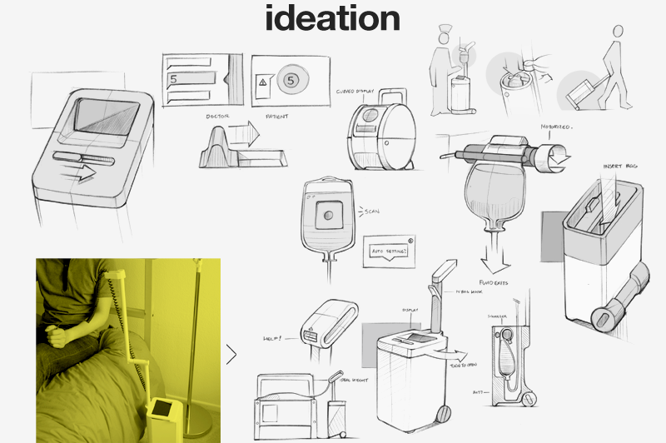
Quick Freehand Sketches
Useful for generating ideas quickly.

Slide 5
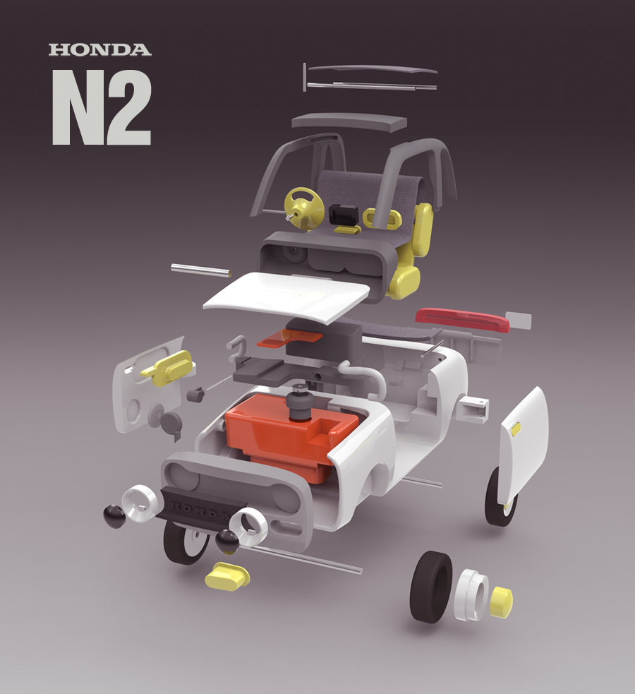
Exploded Drawings
Shows how parts join together.

Slide 6
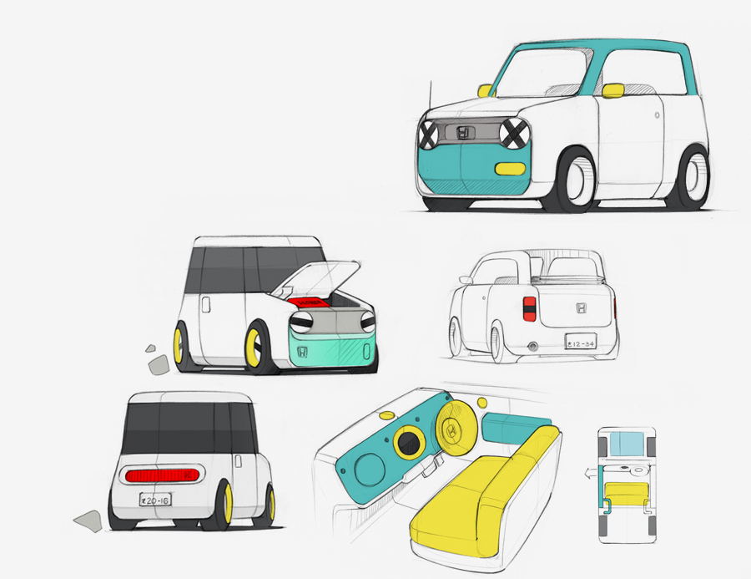
3-dimensional Drawings
Excellent for communication ideas to clients and “non-experts”

Slide 7

Presentation Drawings
Used to communicate design proposals and finished solutions.
Aimed at clients, consumers, retailers.

Slide 8
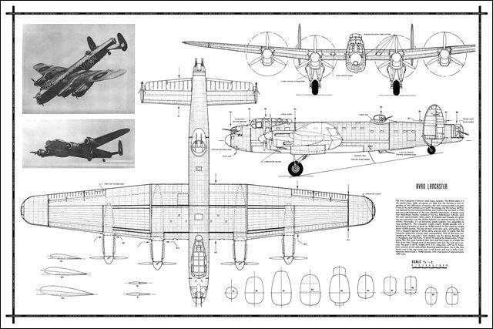
Scale Drawings
Used to make scale models or communicate information to manufacturers,

Slide 9
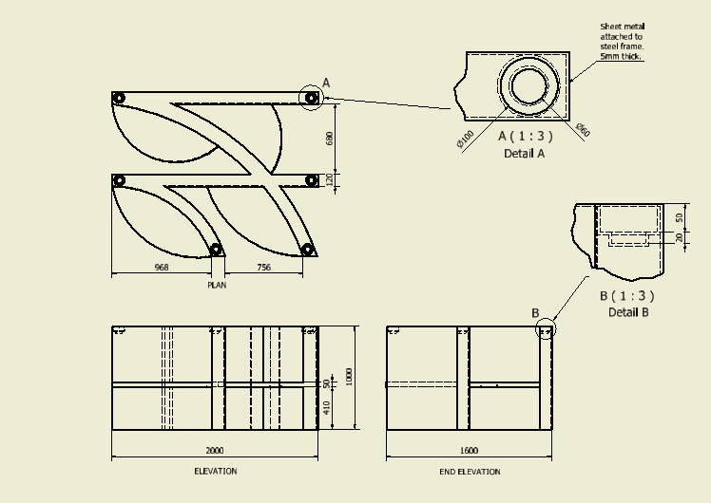
Working Drawings
Necessary for all aspects of product manufacture

Slide 10
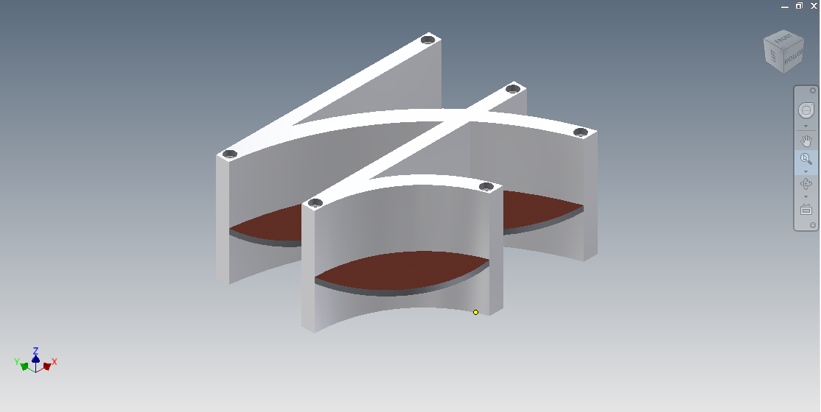
Computer Drawings
Allows changes to be made easily.

Slide 11
Computer Simulations
Ideal for testing and demonstrating how products will react in real life.

Slide 12



World Wide Web
Enables information to be communicated to potential customers all over the world.

Slide 13


Written Reports
Often used to communicate more technical information
  Specifications
  Test results
  Evaluation studies

