Slide 1
Idea Generation Techniques
Where do design ideas come from?

Slide 2
Lifestyle Board
Producing a lifestyle board can be a very easy way of providing an aesthetic direction for the product. It should be full of visual images which give a snapshot of the lifestyle of the target market.

Slide 3
Lifestyle Board

Slide 4
Lifestyle Board
Content of the lifestyle board could contain:
the food they eat;
the clothes they wear;
where they go on holiday;
the houses they live in;
The cars they drive;
the music they listen to;
the leisure activities they undertake;
the style of furniture in their home;
the products they own and aspire to own.

Slide 5
Mood Board
A mood board is similar to a lifestyle board in that it brings together visual images from a range of sources and it is used as a stimulus for new ideas. The difference is that a mood board should create an atmosphere which reflects a chosen mood.

Slide 6
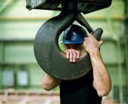
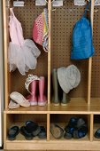
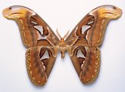
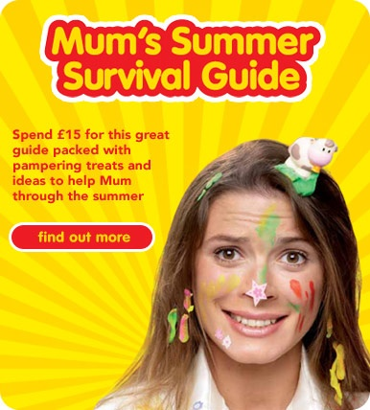
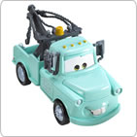
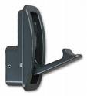
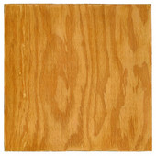
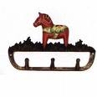
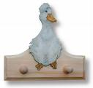
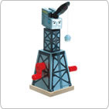
Mood Board

Slide 7
Mood Board
A mood board can also be a way of visual brainstorming where the images created by a mood are recorded and then pictures are found to illustrate them.
A lifestyle board is the result of a much more analytical process where the product’s market segment is studied and visual images are then collected.

Slide 8
Task
Produce a lifestyle or mood board that could be used to illustrate the type of person who would buy garden tool storage Or
As a visual brainstorming for the product

Slide 9
Analogy
Analogies are very good for discovering things you had not realised about the problem or product and thus enable you to develop new solutions.
Often an analogy will include the words "... is like ..."
The first step is to make up an analogy:
What does the problem or product remind you of?
What other areas of life/work experience similar situations?

Slide 10
Analogy
Analogy’s success depends on your ability to identify useful lines of thought. For example engineers faced a problem when designing a new aircraft carrier for the sea harrier jets. The decks were too short for the planes to take off with a full load, unless the carrier steamed at full speed into the wind. It was the analogy which likened this problem to water ski jumping that provided the breakthrough and led to the ramp take off being successfully developed.

Slide 11
Morphological Analysis
One way to come up with a really good design is to have lots of ideas and then throw away all the bad ones. Morphological analysis is a simple technique which can suggest thousands of possible ideas. It is carried out by breaking the problem down into its main features. Each of these features is written on the top of a separate card and then a variety of options are noted below. These lists are laid side-by-side and moved up and down at random. Any interesting combinations are noted for sketching later.

Slide 12
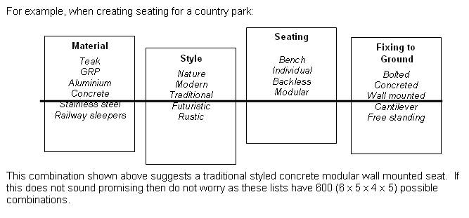
Morphological Analysis
For example, when creating seating for a country park:
This combination shown above suggests a traditional styled concrete modular wall mounted seat. If this does not sound promising then do not worry as these lists have 600 (6*5*4*5) possible combinations

Slide 13
Attribute Analysis
Attribute analysis is very similar to morphological analysis but its starting point is an existing product. The main features of the product are noted on a table and then lists of alternatives are written in the columns below. The alternatives from each column are combined at random and any promising suggestions are noted for sketching later.

Slide 14
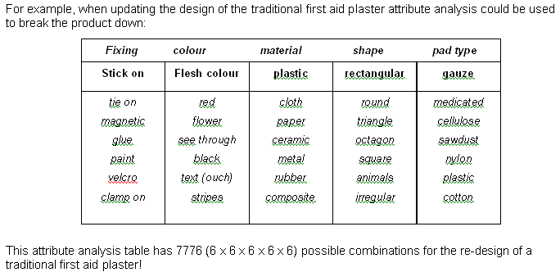
Attribute Analysis
For example, when updating the design of the traditional first aid plaster, attribute analysis could be used to break the product down:
This attribute analysis table has 7776 (6*6*6*6*6) possible combinations for the redesign of a traditional first aid plaster

Slide 15
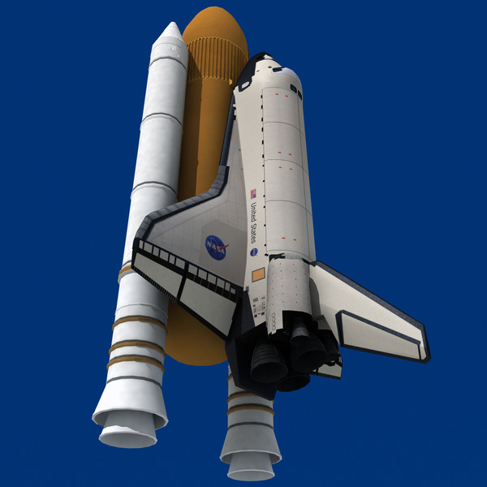
Technology Transfer
New products, ideas and inventions are often the result of a process called associative thinking. This means that a designer will make a link with the technology in one field of design and use it to provide a new idea or solution in another. There are many examples, such as:
Laser technology developed for space and defence programmes is now used in DVD systems.
Dyson adapted the technology found in a sawmill dust extraction system for use in his vacuum cleaners.
The principle of ski bindings is now used in bicycle SPD pedals and shoes.
These examples show how a technology which already exists can be transferred without further development and used in the design of a completely new product.

Slide 16
Lateral Thinking
We all have habits in the way we think. These habits can often block our ability to correctly perceive a problem and create a solution. Lateral thinking is about looking at the problem in a different way and avoiding our everyday vertical type approach to thinking.
In lateral thinking, it is not necessary to be right at every step since it is sometimes desirable to be wrong in order to organise and alter information or ideas. Challenging accepted concepts and information is what makes lateral thinking so important. Like a young child, lateral thinking constantly asks `why?’

Slide 17
Lateral Thinking
For example, lateral thinking could be used to generate ideas for supporting a table top (note that the word leg is not used):
hang it from the ceiling;
the top is the support;
use magnets to support the top;
attach the top to a wall;
support the top with water.
As before these are starting points which need to be analysed and developed further using sketches.

